Slide 1

Manufacturing Master Data
Presented By: Amol Sutar
Date: 02-May-2025

Slide 2
Agenda
Manufacturing Basic Data
Item Master
Bill of Material
Work Center
Routing
Planning Parameters
Manufacturing Lead Time
Purchase Lead Time
Safety Stock
Manufacturing
Notes:
THIS DISCUSSION MAY NEED TO BE CONTINUED WHEN THE OPERATIONS TEAM MEMBERS JOIN THE MEETING
Where are the manufacturing locations?
How is this planned?
Are the methods of Manufacture the same at each site?
Are the same product manufactured at each site?
Do they use Sub-Contacting?
Requirements for Lot numbers / Serialization
Quality requirements?
Legal / Regulatory requirements?
Do the different locations have different work methods which may affect the control files, which are a Domain level.
Some time help to create a diagram of the locations and inventory movements

Slide 3
Item Master

Slide 4
Item Master
An item master is a record of all the key information about a particular item of inventory.
Contains attributes like item description, specifications, size, weight, and manufacturing information
Cost Data
Standard Cost ( Direct & Indirect cost)
Inventory Information
Current Stock Levels, minimum order quantities & lead times
Supplier Information
Details about supplier
Notes:
THIS DISCUSSION MAY NEED TO BE CONTINUED WHEN THE OPERATIONS TEAM MEMBERS JOIN THE MEETING
Where are the manufacturing locations?
How is this planned?
Are the methods of Manufacture the same at each site?
Are the same product manufactured at each site?
Do they use Sub-Contacting?
Requirements for Lot numbers / Serialization
Quality requirements?
Legal / Regulatory requirements?
Do the different locations have different work methods which may affect the control files, which are a Domain level.
Some time help to create a diagram of the locations and inventory movements

Slide 5
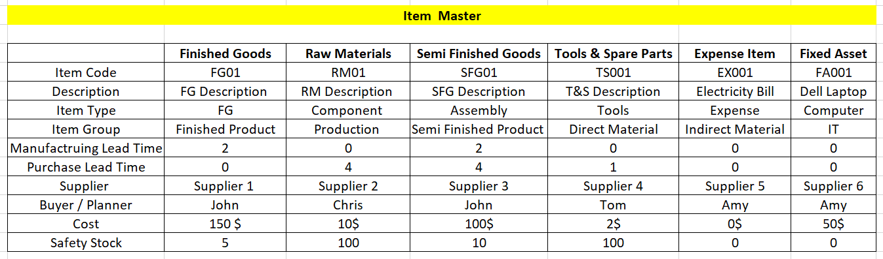
Item Master
Notes:
THIS DISCUSSION MAY NEED TO BE CONTINUED WHEN THE OPERATIONS TEAM MEMBERS JOIN THE MEETING
Where are the manufacturing locations?
How is this planned?
Are the methods of Manufacture the same at each site?
Are the same product manufactured at each site?
Do they use Sub-Contacting?
Requirements for Lot numbers / Serialization
Quality requirements?
Legal / Regulatory requirements?
Do the different locations have different work methods which may affect the control files, which are a Domain level.
Some time help to create a diagram of the locations and inventory movements

Slide 6
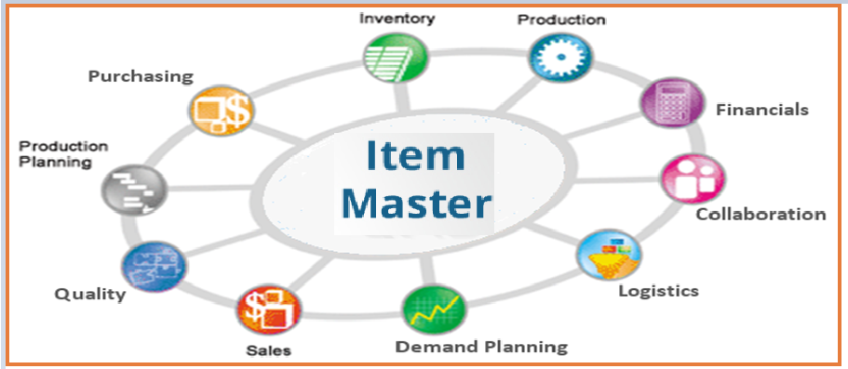
Item Master
Notes:
THIS DISCUSSION MAY NEED TO BE CONTINUED WHEN THE OPERATIONS TEAM MEMBERS JOIN THE MEETING
Where are the manufacturing locations?
How is this planned?
Are the methods of Manufacture the same at each site?
Are the same product manufactured at each site?
Do they use Sub-Contacting?
Requirements for Lot numbers / Serialization
Quality requirements?
Legal / Regulatory requirements?
Do the different locations have different work methods which may affect the control files, which are a Domain level.
Some time help to create a diagram of the locations and inventory movements

Slide 7
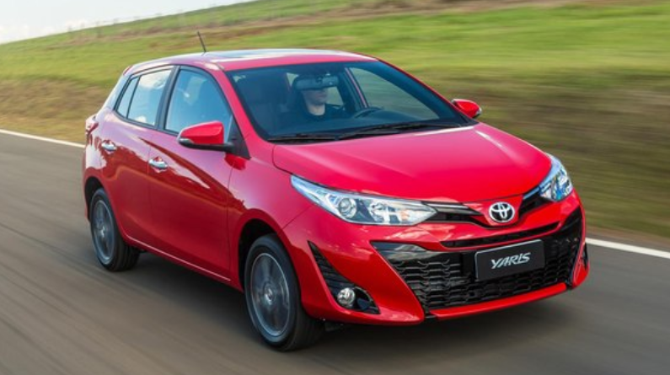
Item Master Example
Notes:
THIS DISCUSSION MAY NEED TO BE CONTINUED WHEN THE OPERATIONS TEAM MEMBERS JOIN THE MEETING
Where are the manufacturing locations?
How is this planned?
Are the methods of Manufacture the same at each site?
Are the same product manufactured at each site?
Do they use Sub-Contacting?
Requirements for Lot numbers / Serialization
Quality requirements?
Legal / Regulatory requirements?
Do the different locations have different work methods which may affect the control files, which are a Domain level.
Some time help to create a diagram of the locations and inventory movements

Slide 8
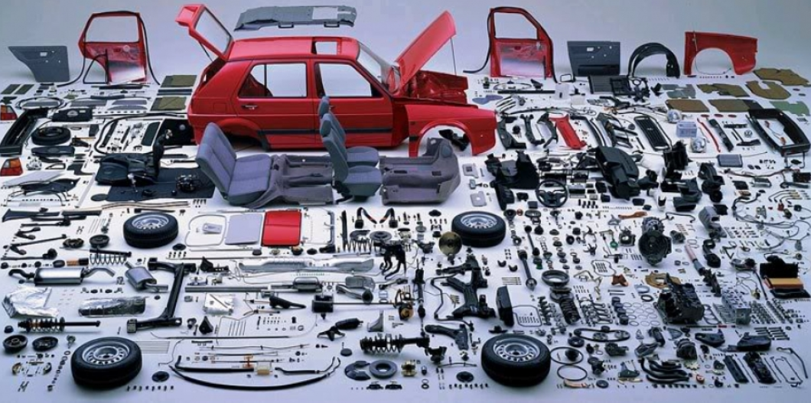
Item Master Example
Notes:
THIS DISCUSSION MAY NEED TO BE CONTINUED WHEN THE OPERATIONS TEAM MEMBERS JOIN THE MEETING
Where are the manufacturing locations?
How is this planned?
Are the methods of Manufacture the same at each site?
Are the same product manufactured at each site?
Do they use Sub-Contacting?
Requirements for Lot numbers / Serialization
Quality requirements?
Legal / Regulatory requirements?
Do the different locations have different work methods which may affect the control files, which are a Domain level.
Some time help to create a diagram of the locations and inventory movements

Slide 9
Bill of Material

Slide 10
Bill of Material
A Bill of Materials (BOM) is a structured list that details all the raw materials, sub-assemblies, components, and parts needed to manufacture a product.
Comprehensive Inventory
It lists every item required, from raw materials to finished sub-assemblies.
Quantity Specifications:
It specifies the exact quantities of each component needed.
Hierarchical Structure:
BOMs can be single-level, showing only the direct components, or multi-level, outlining the relationships between sub-assemblies and their components.
Notes:
THIS DISCUSSION MAY NEED TO BE CONTINUED WHEN THE OPERATIONS TEAM MEMBERS JOIN THE MEETING
Where are the manufacturing locations?
How is this planned?
Are the methods of Manufacture the same at each site?
Are the same product manufactured at each site?
Do they use Sub-Contacting?
Requirements for Lot numbers / Serialization
Quality requirements?
Legal / Regulatory requirements?
Do the different locations have different work methods which may affect the control files, which are a Domain level.
Some time help to create a diagram of the locations and inventory movements

Slide 11
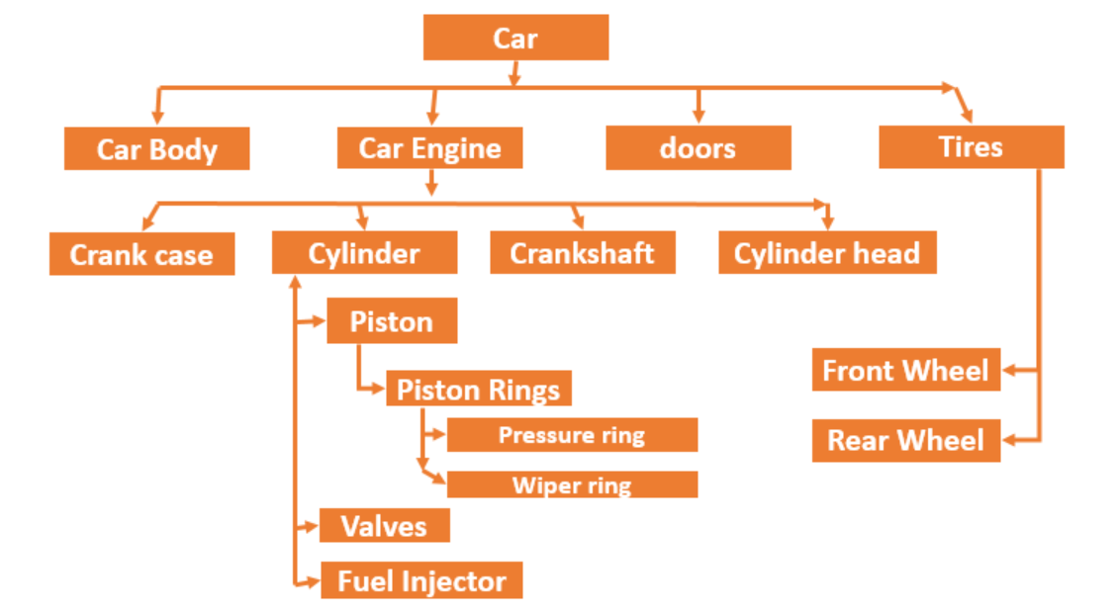
Bill of Material
Notes:
THIS DISCUSSION MAY NEED TO BE CONTINUED WHEN THE OPERATIONS TEAM MEMBERS JOIN THE MEETING
Where are the manufacturing locations?
How is this planned?
Are the methods of Manufacture the same at each site?
Are the same product manufactured at each site?
Do they use Sub-Contacting?
Requirements for Lot numbers / Serialization
Quality requirements?
Legal / Regulatory requirements?
Do the different locations have different work methods which may affect the control files, which are a Domain level.
Some time help to create a diagram of the locations and inventory movements

Slide 12
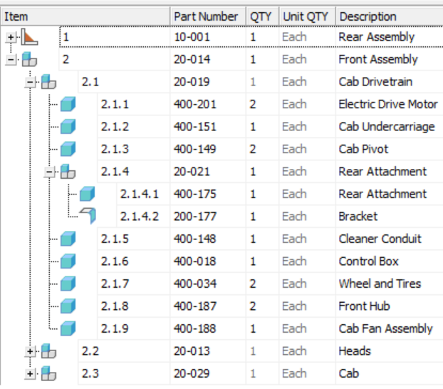
Bill of Material
Notes:
THIS DISCUSSION MAY NEED TO BE CONTINUED WHEN THE OPERATIONS TEAM MEMBERS JOIN THE MEETING
Where are the manufacturing locations?
How is this planned?
Are the methods of Manufacture the same at each site?
Are the same product manufactured at each site?
Do they use Sub-Contacting?
Requirements for Lot numbers / Serialization
Quality requirements?
Legal / Regulatory requirements?
Do the different locations have different work methods which may affect the control files, which are a Domain level.
Some time help to create a diagram of the locations and inventory movements

Slide 13
Work Center

Slide 14
Work Center
A work center is a physical or logical location where work is performed, often within a manufacturing or production environment.
Physical or Logical:
Work centers can be a defined physical area (like a specific workshop) or a logical grouping of resources (like a team of employees performing a specific task).
Resource Management:
They allow for the allocation of resources (machines, labor, materials) to specific tasks or operations.
Scheduling and Routing:
Work centers are used to schedule and route operations, ensuring that tasks are performed in the correct sequence and at the appropriate location.
Notes:
THIS DISCUSSION MAY NEED TO BE CONTINUED WHEN THE OPERATIONS TEAM MEMBERS JOIN THE MEETING
Where are the manufacturing locations?
How is this planned?
Are the methods of Manufacture the same at each site?
Are the same product manufactured at each site?
Do they use Sub-Contacting?
Requirements for Lot numbers / Serialization
Quality requirements?
Legal / Regulatory requirements?
Do the different locations have different work methods which may affect the control files, which are a Domain level.
Some time help to create a diagram of the locations and inventory movements

Slide 15
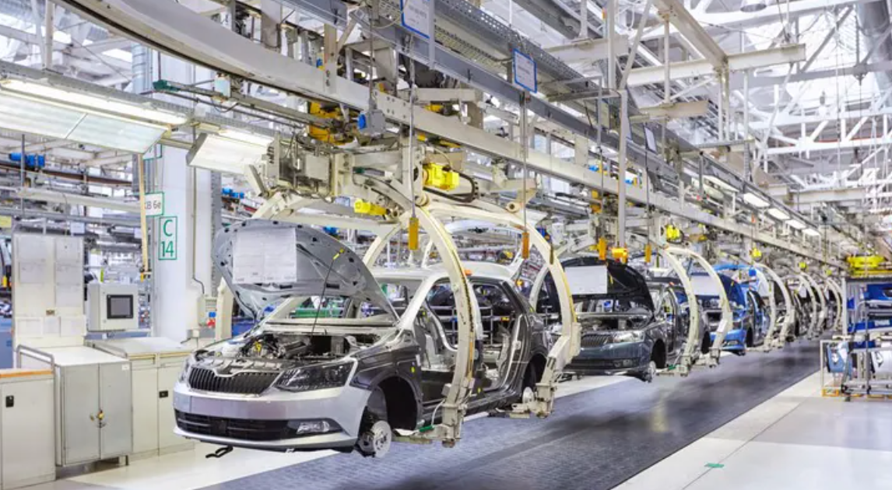
Work Center example
Notes:
THIS DISCUSSION MAY NEED TO BE CONTINUED WHEN THE OPERATIONS TEAM MEMBERS JOIN THE MEETING
Where are the manufacturing locations?
How is this planned?
Are the methods of Manufacture the same at each site?
Are the same product manufactured at each site?
Do they use Sub-Contacting?
Requirements for Lot numbers / Serialization
Quality requirements?
Legal / Regulatory requirements?
Do the different locations have different work methods which may affect the control files, which are a Domain level.
Some time help to create a diagram of the locations and inventory movements

Slide 16
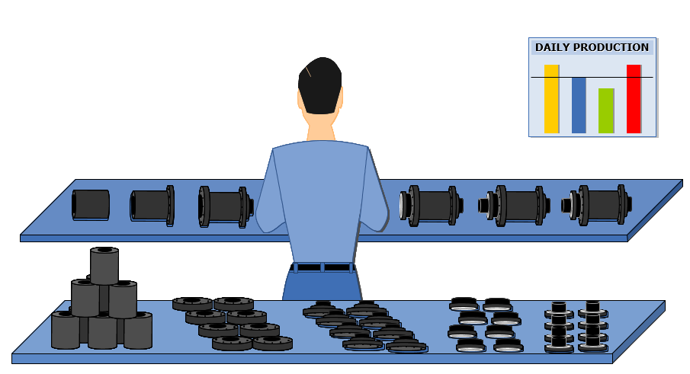
Work Center example
Notes:
THIS DISCUSSION MAY NEED TO BE CONTINUED WHEN THE OPERATIONS TEAM MEMBERS JOIN THE MEETING
Where are the manufacturing locations?
How is this planned?
Are the methods of Manufacture the same at each site?
Are the same product manufactured at each site?
Do they use Sub-Contacting?
Requirements for Lot numbers / Serialization
Quality requirements?
Legal / Regulatory requirements?
Do the different locations have different work methods which may affect the control files, which are a Domain level.
Some time help to create a diagram of the locations and inventory movements

Slide 17
Routing

Slide 18
Routing
Routing refers to the sequential order of operations needed to transform raw materials into finished products
Defining the Production Flow:
Routing maps out the step-by-step process of manufacturing, from initial raw materials to the final product, ensuring that each task is performed in the correct order.
Resource Allocation:
Routing also helps determine which work centers, machines, and labor resources are needed for each operation, facilitating effective resource planning and allocation.
Notes:
THIS DISCUSSION MAY NEED TO BE CONTINUED WHEN THE OPERATIONS TEAM MEMBERS JOIN THE MEETING
Where are the manufacturing locations?
How is this planned?
Are the methods of Manufacture the same at each site?
Are the same product manufactured at each site?
Do they use Sub-Contacting?
Requirements for Lot numbers / Serialization
Quality requirements?
Legal / Regulatory requirements?
Do the different locations have different work methods which may affect the control files, which are a Domain level.
Some time help to create a diagram of the locations and inventory movements

Slide 19
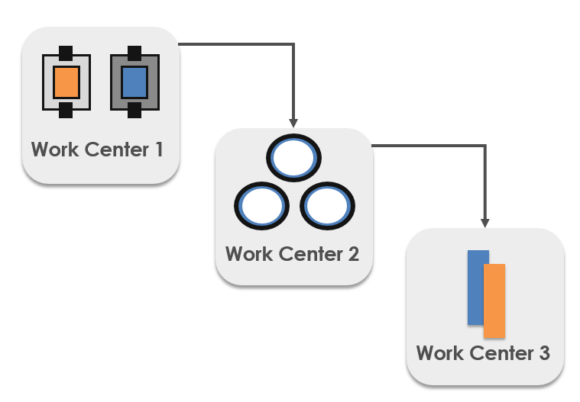
Routing
EOB Domain Workshop
Notes:
THIS DISCUSSION MAY NEED TO BE CONTINUED WHEN THE OPERATIONS TEAM MEMBERS JOIN THE MEETING
Where are the manufacturing locations?
How is this planned?
Are the methods of Manufacture the same at each site?
Are the same product manufactured at each site?
Do they use Sub-Contacting?
Requirements for Lot numbers / Serialization
Quality requirements?
Legal / Regulatory requirements?
Do the different locations have different work methods which may affect the control files, which are a Domain level.
Some time help to create a diagram of the locations and inventory movements

Slide 20

Routing
Notes:
THIS DISCUSSION MAY NEED TO BE CONTINUED WHEN THE OPERATIONS TEAM MEMBERS JOIN THE MEETING
Where are the manufacturing locations?
How is this planned?
Are the methods of Manufacture the same at each site?
Are the same product manufactured at each site?
Do they use Sub-Contacting?
Requirements for Lot numbers / Serialization
Quality requirements?
Legal / Regulatory requirements?
Do the different locations have different work methods which may affect the control files, which are a Domain level.
Some time help to create a diagram of the locations and inventory movements

Slide 21
Planning Parameters

Slide 22
Planning Parameters
Manufacturing Lead Time
Manufacturing lead time is the total time it takes for a product to move through the entire production process, from initial order placement to final shipment.
It includes order preparation, Sourcing & Procurement, Production, Quality control, Packaging & shipping.
Purchase Lead Time
Purchase Lead time refers to the time it takes for a company to receive an order after it has been placed with a supplier.
Safety Stock / Capacity
Safety stock, also known as buffer stock, is extra inventory held to mitigate the risk of stockouts due to unforeseen circumstances, such as demand fluctuations or supply chain disruptions
Notes:
THIS DISCUSSION MAY NEED TO BE CONTINUED WHEN THE OPERATIONS TEAM MEMBERS JOIN THE MEETING
Where are the manufacturing locations?
How is this planned?
Are the methods of Manufacture the same at each site?
Are the same product manufactured at each site?
Do they use Sub-Contacting?
Requirements for Lot numbers / Serialization
Quality requirements?
Legal / Regulatory requirements?
Do the different locations have different work methods which may affect the control files, which are a Domain level.
Some time help to create a diagram of the locations and inventory movements

Slide 23
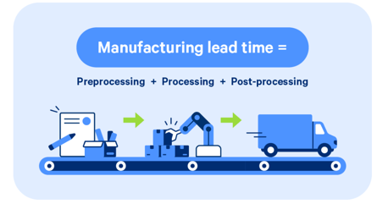
Manufacturing Lead Time
Notes:
THIS DISCUSSION MAY NEED TO BE CONTINUED WHEN THE OPERATIONS TEAM MEMBERS JOIN THE MEETING
Where are the manufacturing locations?
How is this planned?
Are the methods of Manufacture the same at each site?
Are the same product manufactured at each site?
Do they use Sub-Contacting?
Requirements for Lot numbers / Serialization
Quality requirements?
Legal / Regulatory requirements?
Do the different locations have different work methods which may affect the control files, which are a Domain level.
Some time help to create a diagram of the locations and inventory movements

Slide 24
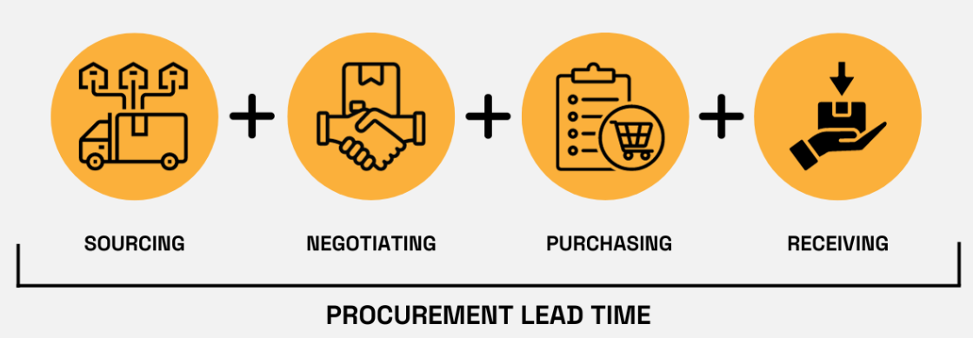
Purchase Lead Time
EOB Domain Workshop
Notes:
THIS DISCUSSION MAY NEED TO BE CONTINUED WHEN THE OPERATIONS TEAM MEMBERS JOIN THE MEETING
Where are the manufacturing locations?
How is this planned?
Are the methods of Manufacture the same at each site?
Are the same product manufactured at each site?
Do they use Sub-Contacting?
Requirements for Lot numbers / Serialization
Quality requirements?
Legal / Regulatory requirements?
Do the different locations have different work methods which may affect the control files, which are a Domain level.
Some time help to create a diagram of the locations and inventory movements

Slide 25
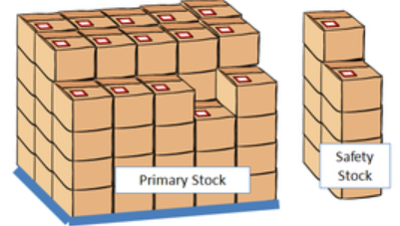

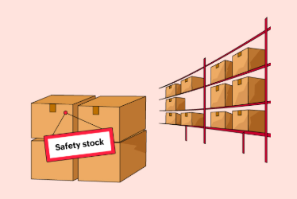
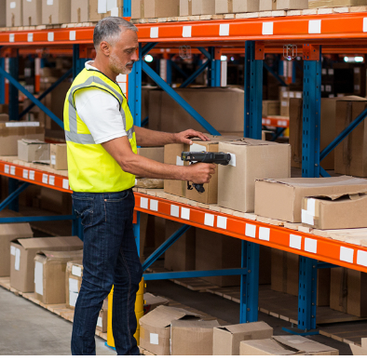
Safety Stock / capacity
Notes:
THIS DISCUSSION MAY NEED TO BE CONTINUED WHEN THE OPERATIONS TEAM MEMBERS JOIN THE MEETING
Where are the manufacturing locations?
How is this planned?
Are the methods of Manufacture the same at each site?
Are the same product manufactured at each site?
Do they use Sub-Contacting?
Requirements for Lot numbers / Serialization
Quality requirements?
Legal / Regulatory requirements?
Do the different locations have different work methods which may affect the control files, which are a Domain level.
Some time help to create a diagram of the locations and inventory movements

Slide 26
Questions ?
Thank You
Notes:
Questions?
Next Steps…
Thank You

